Slide 1


Through the Years
1905-Present Day

Slide 2
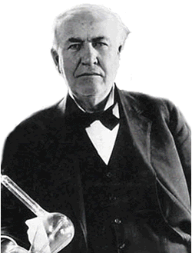


1905
Thomas Alva Edison was instrumental in forming the company known as Ebasco Services Incorporated
1905
2008

Slide 3
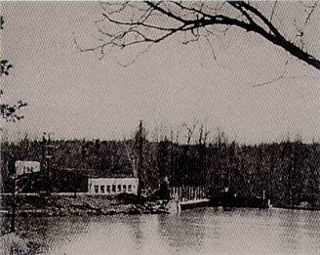
1908
Ebasco engineered and constructed its first hydroelectric facility, the 29-megawatt (MW) Buckhorn Hydroelectric Development Project in North Carolina for Carolina Power & Light Company
1908
1905

Slide 4
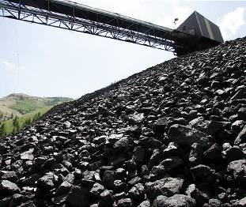
1914
Ebasco completed its first fossil-fired unit, Waco, for Texas Power
& Light
1914
1908

Slide 5
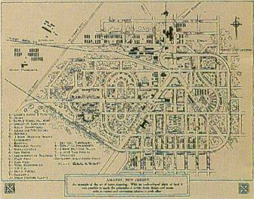
1918
Ebasco extended its activities outside the utility field to construct a shell-loading plant in New Jersey to assist the war effort
1918
1908
1914

Slide 6
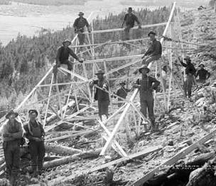
1920s
In the 1920s Ebasco installed twin 33-kilovolt transmission lines for the Philadelphia Electric Company
1920s
1914
1908
1918

Slide 7
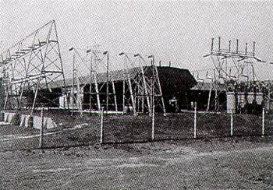
1935
Ebasco Services Incorporated was organized to provide professional services
1935
1914
1920s
1908
1918

Slide 8
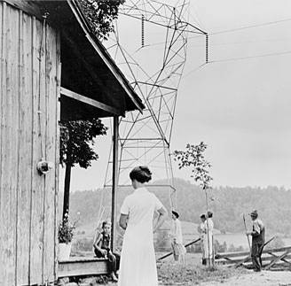
1940
By 1940 more than 2,000 communities had received their first electric service through Electric Bond and Share’s financing or development
1940
1914
1920s
1908
1918
1935

Slide 9
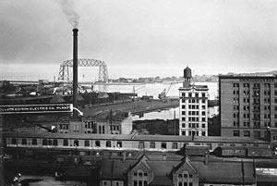
1954
At year-end 1954 Ebasco had constructed and placed into operation plants and equipment valued at more than $2 billion
1954
1914
1920s
1940
1908
1918
1935

Slide 10
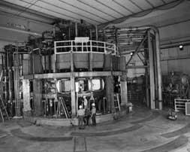
1960s
In the ‘60s Ebasco developed the first quality assurance program for the advanced test reactor
1960s
1914
1920s
1940
1908
1918
1935
1954

Slide 11
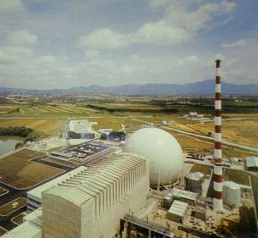
1963
Ebasco completed its first nuclear power plant project, a 180-MW plant in Italy for the Societa Elettronucleare Nazionale
1963
1914
1920s
1940
1908
1918
1935
1954
1960s

Slide 12
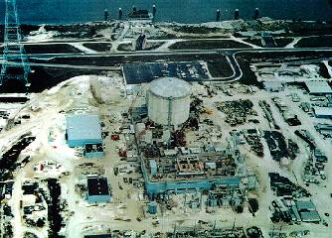
1970s
Successfully performed engineering, design, licensing, construction management, QC, QA, cost accounting, scheduling, procurement, HVAC installation, and start-up and test services of the Waterford Nuclear Power Plant for Louisiana Power & Light Company
1970s
1914
1920s
1940
1960s
1970
1908
1918
1935
1954
1963

Slide 13
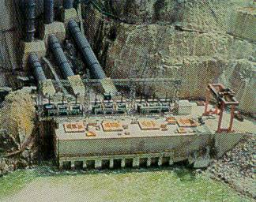
1976
The Gokcekaya Hydroelectric Development Project in Turkey, for which Ebasco provided engineering and construction management services, received the Ingersoll-Rand Italia prize
1976
1914
1920s
1940
1960s
1970
1908
1918
1935
1954
1963
1970s

Slide 14
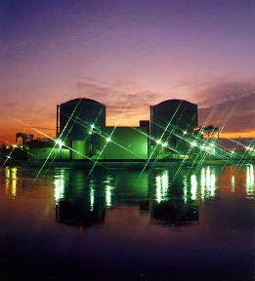
1977
Ebasco began construction of St. Lucie Unit 2 for Florida Power & Light Company. The project, which was completed in record time, is cited as a textbook example of excellence in nuclear power plant design and construction
1977
1914
1920s
1940
1960s
1970
1908
1918
1935
1954
1963
1970s
1976

Slide 15
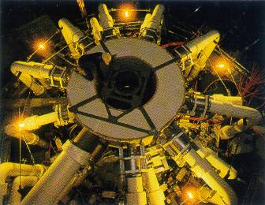
1982
The Tokamak Fusion Test Reactor generated its first plasma, bringing fusion power a step closer to reality
1982
1914
1920s
1940
1960s
1970
1908
1918
1935
1954
1963
1970s
1977
1976
1978

Slide 16
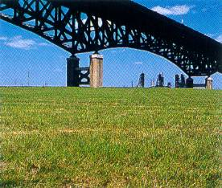
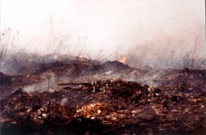
1987
The Consulting Engineers Council of New Jersey honored Ebasco with the Award for Engineering Excellence for the successful reclamation of the toxic PJP landfill
1987
1914
1920s
1940
1960s
1970
1908
1918
1935
1954
1963
1970s
1977
1982
1976
1978
1983

Slide 17
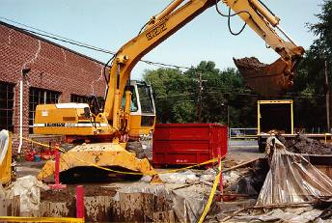
1988
Alternative Remedial Contracting Strategy (ARCS) II USEPA Region II
We were responsible for the performance of multiple, concurrent investigations, remedial design activities, and remedial actions at 275 uncontrolled hazardous waste NPL CERCLA sites under centralized program management
1988
1914
1920s
1940
1960s
1970
1908
1918
1935
1954
1963
1970s
1977
1982
1987
1976
1978
1983

Slide 18
1989
J-6 Large Rocket Test Facility. Site Management integrator for construction of the largest Rocket Test Facility in the U.S., employing the most sophisticated technology. The test facility is capable of testing solid fuel rocket motors of a 500,000-lb thrust simulated at 100,000ft. altitude. The project was completed $12M under client’s budget and 114 days ahead of schedule. The J-6 Team was awarded the worldwide USACE 1993 Military Construction Contractor of the Year award.
1989
1914
1920s
1940
1960s
1970
1908
1918
1935
1954
1963
1970s
1977
1982
1987
1976
1978
1983
1988

Slide 19
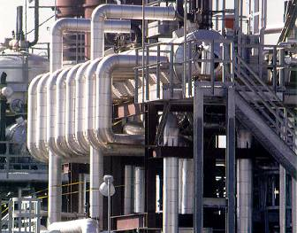
1989
In 1989 the Encogen One cogeneration project went on line. Ebasco was turnkey constructor for the 255-MW facility located near Sweetwater, Texas
1989
1914
1920s
1940
1960s
1970
1908
1918
1935
1954
1963
1970s
1977
1982
1987
1976
1978
1983
1988

Slide 20
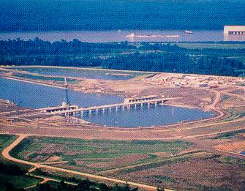
1990
The S.A. Murray Jr. Hydroelectric Station in Vidalia, LA., became operational. Ebasco was turnkey constructor for the 192-MW facility which is the nation’s largest, private low-head hydropower project
1990
1914
1920s
1940
1960s
1970
1908
1918
1935
1954
1963
1970s
1977
1982
1987
1989
1976
1978
1983
1988

Slide 21

1993
Ebasco acquired by Raytheon Corporation EXCEPT for Environmental Services Division and parts of Ebasco Constructors
1993
1914
1920s
1940
1960s
1970
1908
1918
1935
1954
1963
1970s
1977
1982
1989
1976
1978
1983
1987
1990

Slide 22

1994
Enserch Environmental Corporation (EEC) formed
1994
1914
1920s
1940
1960s
1970
1908
1918
1935
1954
1963
1970s
1977
1982
1989
1993
1976
1978
1983
1987
1990

Slide 23
1994
EEC acquired by Foster Wheeler Corporation
1994
1914
1920s
1940
1960s
1970
1908
1918
1935
1954
1963
1970s
1977
1982
1989
1993
1976
1978
1983
1987
1990

Slide 24

1994
EEC reintroduced as Foster Wheeler Environmental Corporation (FWENC)
1994
1914
1920s
1940
1960s
1970
1908
1918
1935
1954
1963
1970s
1977
1982
1989
1993
1976
1978
1983
1987
1990

Slide 25
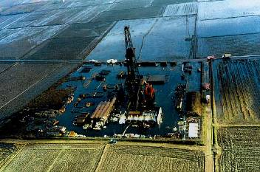
1994
The Trecate Remediation Project is the largest project ever in Italy. It was located in the premier rice growing region, which made it extremely sensitive
1994
1914
1920s
1940
1960s
1970
1908
1918
1935
1954
1963
1970s
1977
1982
1989
1993
1976
1978
1983
1987
1990

Slide 26
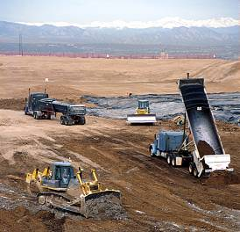
1997
FWENC Awarded $1.2 Billion Rocky Mountain Arsenal clean up
1997
1914
1920s
1940
1960s
1970
1908
1918
1935
1954
1963
1970s
1977
1982
1989
1993
1976
1978
1983
1987
1990
1994

Slide 27
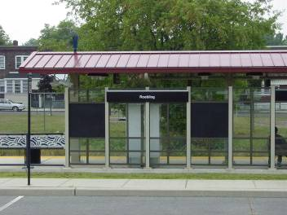
1998
EPA Region 2, Response Action Contract (RAC) II Program
Remedial services, including scientific and engineering investigations and remediation at Superfund sites for 62 different projects located in EPA Region 2
1998
1914
1920s
1940
1960s
1970
1997
1908
1918
1935
1954
1963
1970s
1977
1982
1989
1993
1976
1978
1983
1987
1990
1994

Slide 28

1999
In recognition of the success of Tetra Tech EC, Inc.'s health and safety program, the Occupational Safety and Health Administration (OSHA) awarded our design-build environmental restoration of Rocky Mountain Arsenal project the prestigious Voluntary Protection Program (VPP) Star status. The RMA project is the first environmental restoration project to be honored with VPP Star status in recognition of outstanding safety accomplishment.
1999
1914
1920s
1940
1960s
1970
1908
1918
1935
1954
1963
1970s
1977
1982
1989
1993
1997
1976
1978
1983
1987
1990
1994

Slide 29
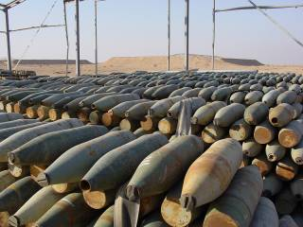
2000
Iraq CEA/CMC – USAESCH Ordnance and Explosives Response Worldwide. Tetra Tech provided cradle-to-grave management (inventory, collect, store, and dispose) of huge quantities of Captured Enemy Ammunition (CEA) and Coalition Munitions Clearance (CMC) in Iraq, including managing ammunition supply/collection points (ASPs), demolition of unserviceable munitions and priority munitions, transportation of CEA/CMC from caches to ASPs, surface clearances, site investigations, evaluations, and responses.
2000
1914
1920s
1940
1960s
1970
1997
1908
1918
1935
1954
1963
1970s
1977
1982
1989
1993
1999
1976
1978
1983
1987
1990
1994

Slide 30
2003
Tetra Tech acquires FWENC, forms TtFW later renamed TtEC
2003
1914
1920s
1940
1960s
1970
1908
1918
1935
1954
1963
1970s
1977
1982
1989
1993
1997
1976
1978
1983
1987
1990
1994

Slide 31
2003
First Wind Services provided by TtEC
Ridgeline Energy, Goshen Wind Project
2003
1914
1920s
1940
1960s
1970
1908
1918
1935
1954
1963
1970s
1977
1982
1989
1993
1997
1976
1978
1983
1987
1990
1994

Slide 32
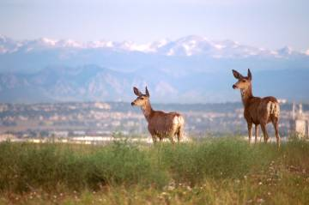
2004
4,930 acres of the RMA's perimeter parcel are transferred from the Army to the U.S. Fish and Wildlife Service to officially become the Rocky Mountain RMA
National Wildlife Refuge
2004
1914
1920s
1940
1960s
1970
1908
1918
1935
1954
1963
1970s
1977
1982
1989
1993
1997
2003
1976
1978
1983
1987
1990
1994

Slide 33
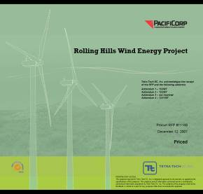
2008
Tetra Tech was awarded three wind energy projects by PacifiCorp to provide engineering, procurement, and construction (EPC) services for the Seven Mile Hill, Glenrock and Rolling Hills wind farm projects in Wyoming.
1914
1920s
1940
1960s
1970
2008
1908
1918
1935
1954
1963
1970s
1977
1982
1989
1993
1997
2003
1976
1978
1983
1987
1990
1994

